Slide 1



QUIZ TIME!
WHAT'S THE MOST TRAFFICKED ANIMAL IN THE WORLD?

Slide 2













Pangolins
PRESENTED BY: TEAM PANGOLIN
RAGIIB
Vivian
Shaheer
Vanessa
Harrison
DHRUV

Slide 3
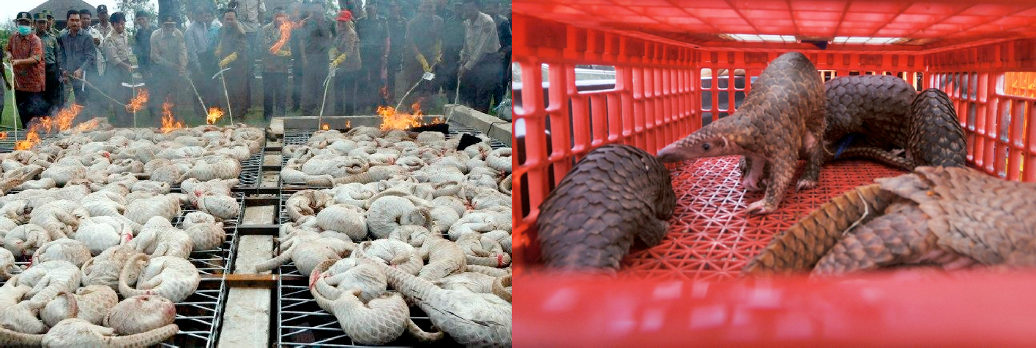
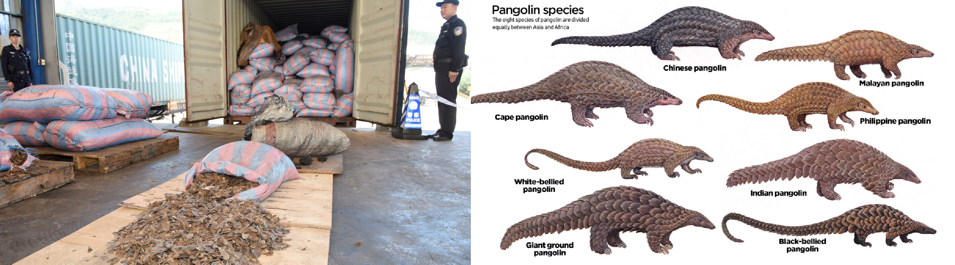




Wicked Problem + Background
Wicked problem
Heavily trafficked in the world
Causing illegal trade and poaching for their meat and scales
Threatening their survival and the health of their ecosystems
Figure 1. Cost of pangolins fuel illegal trade
Figure 2. Pangolins in captive
Background
Wicked problem of pangolins in relation to SDG 15.7
Issues surrounding pangolins Reasons to protect pangolins Achieving goal 15.7
Figure 3. Pangolin scales seized in ShenZhen, China
Figure 4. 8 species of pangolins

Slide 4



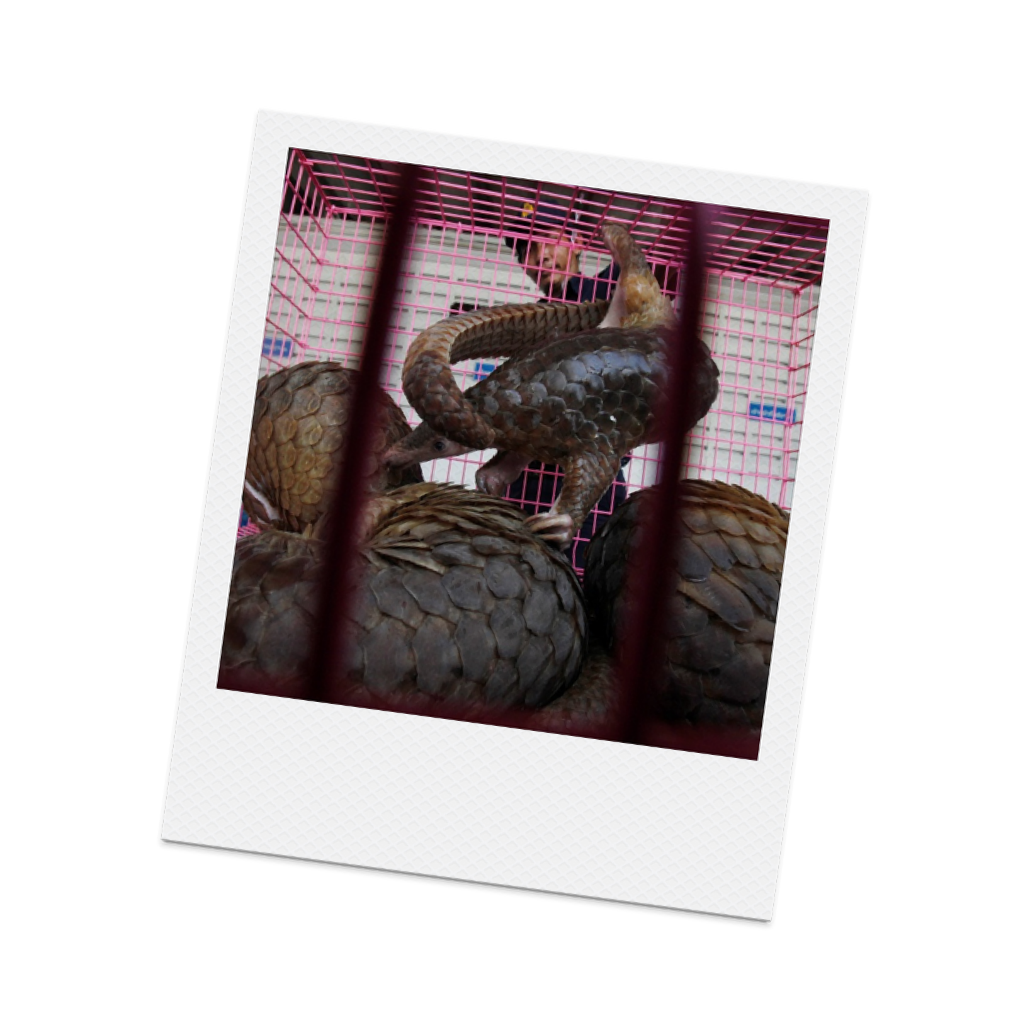
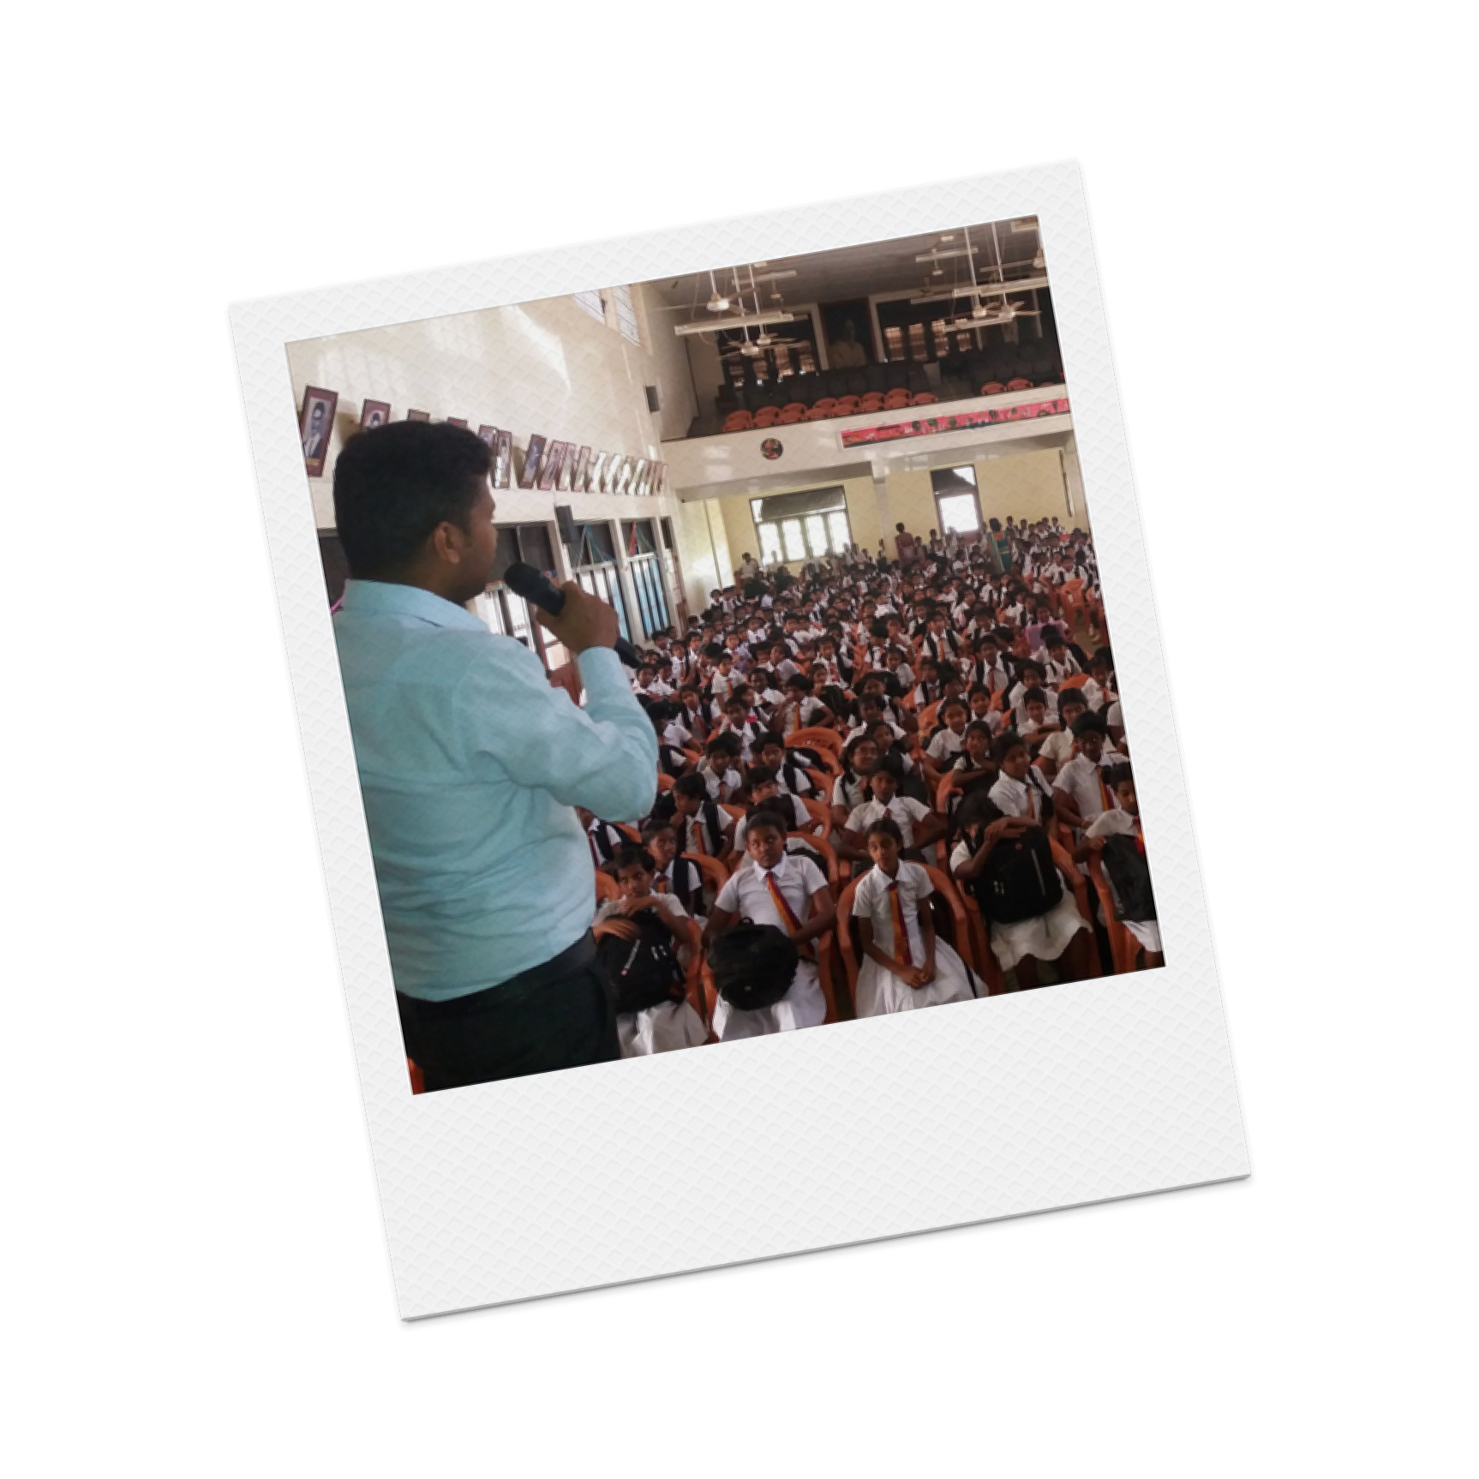
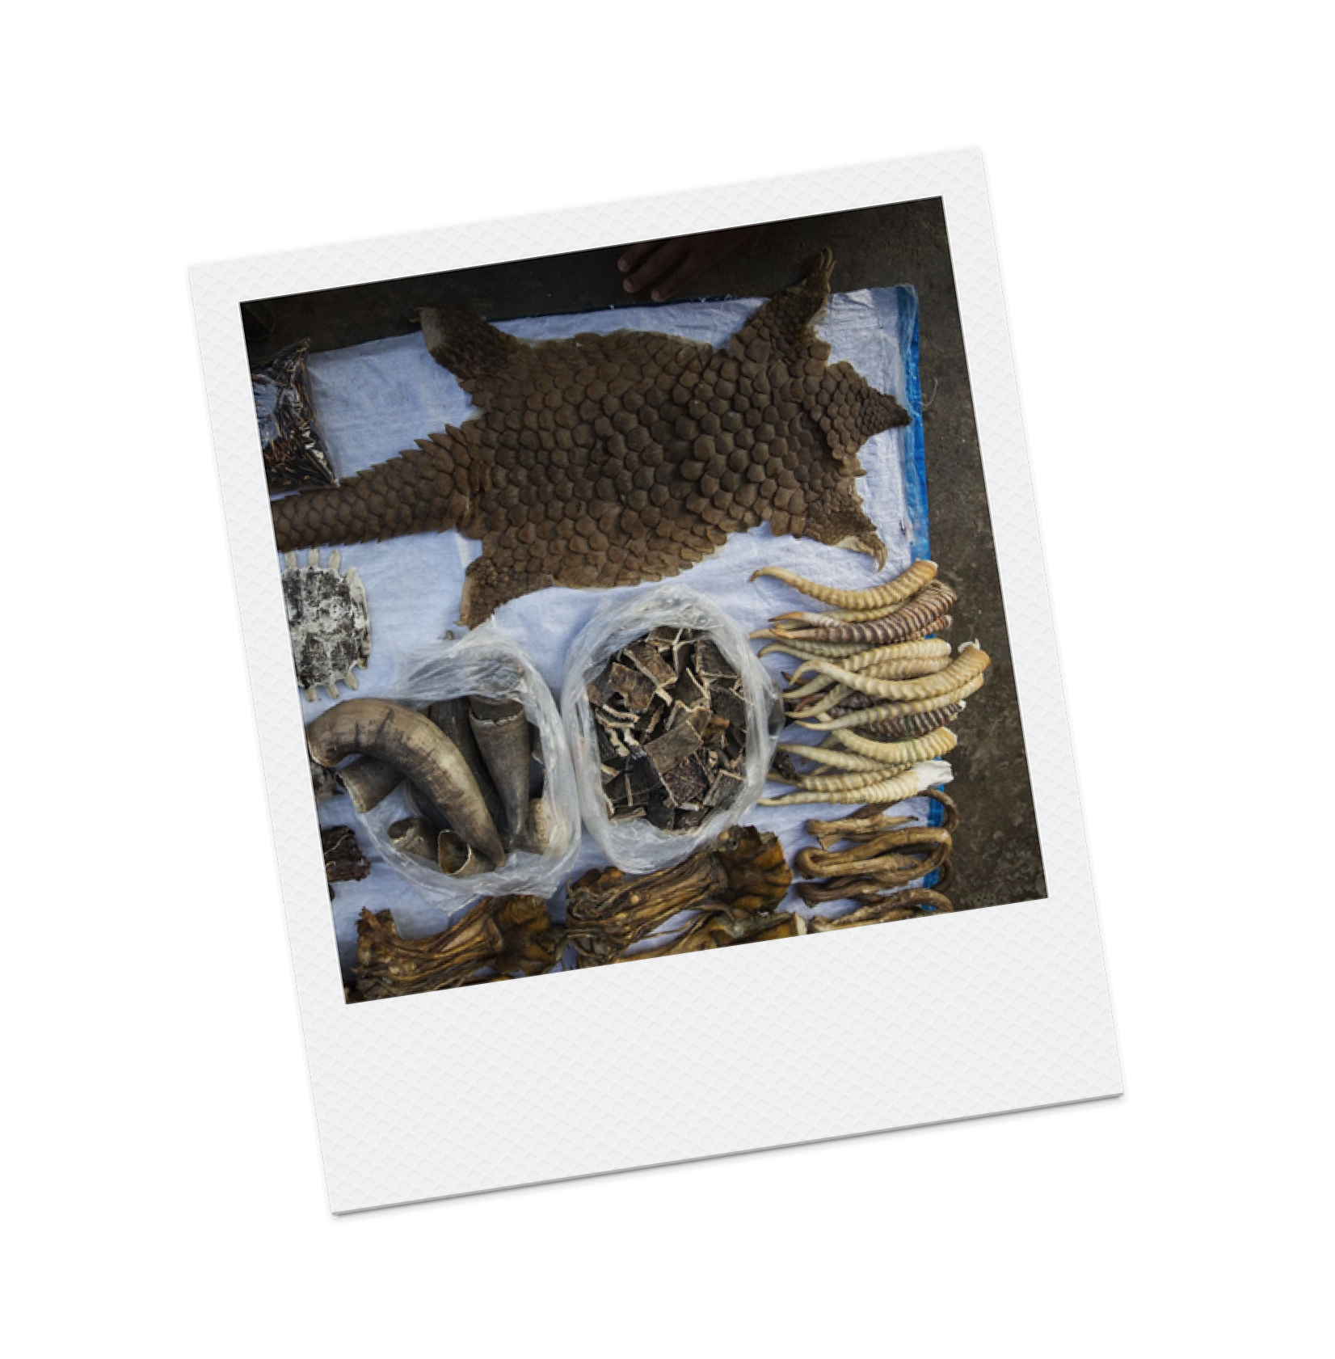
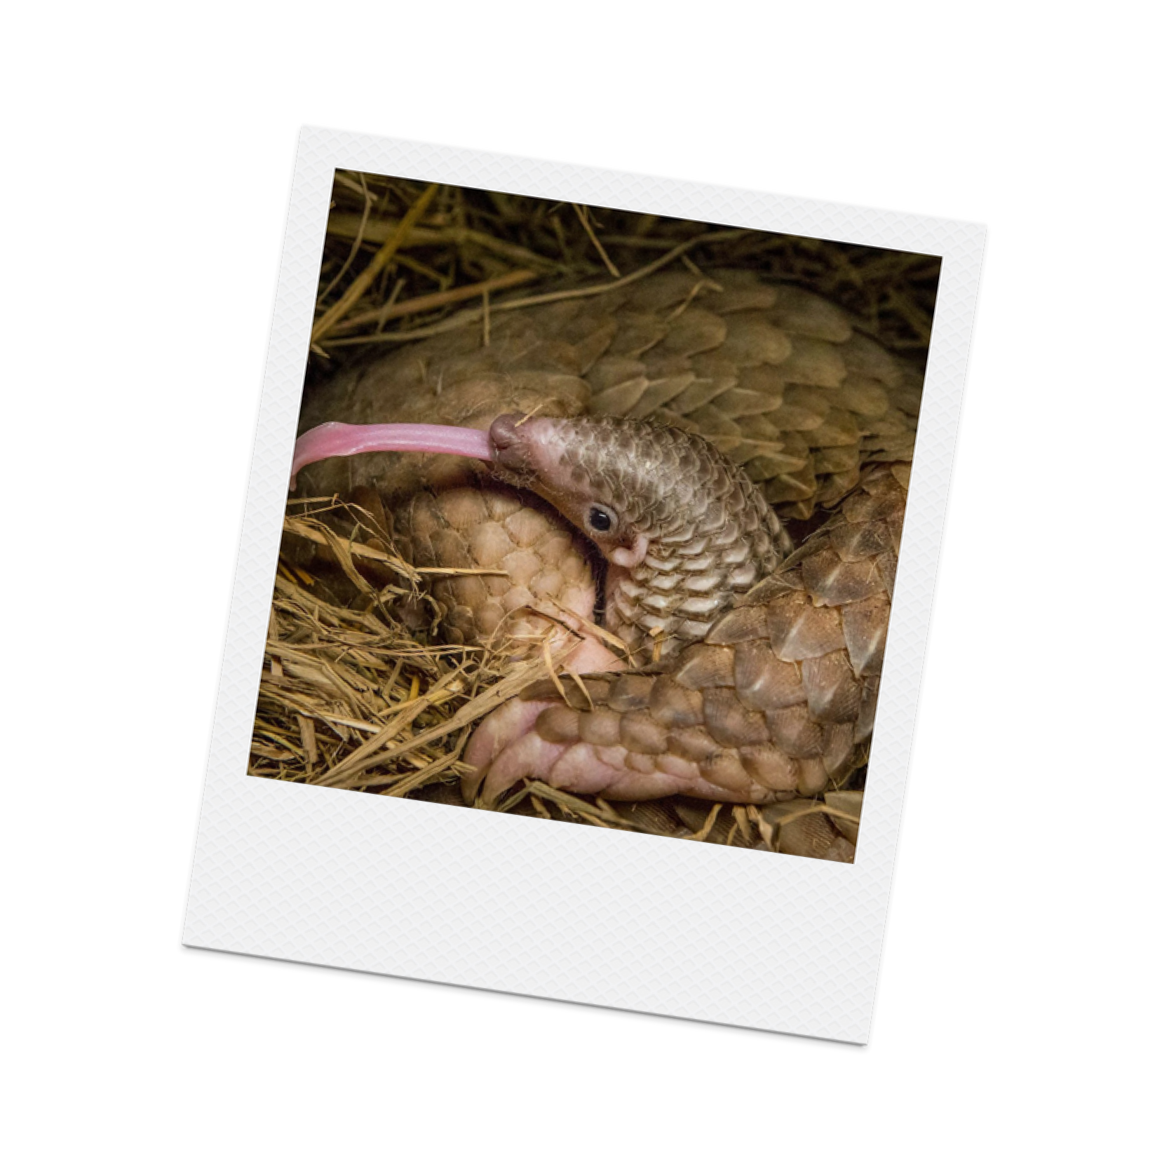

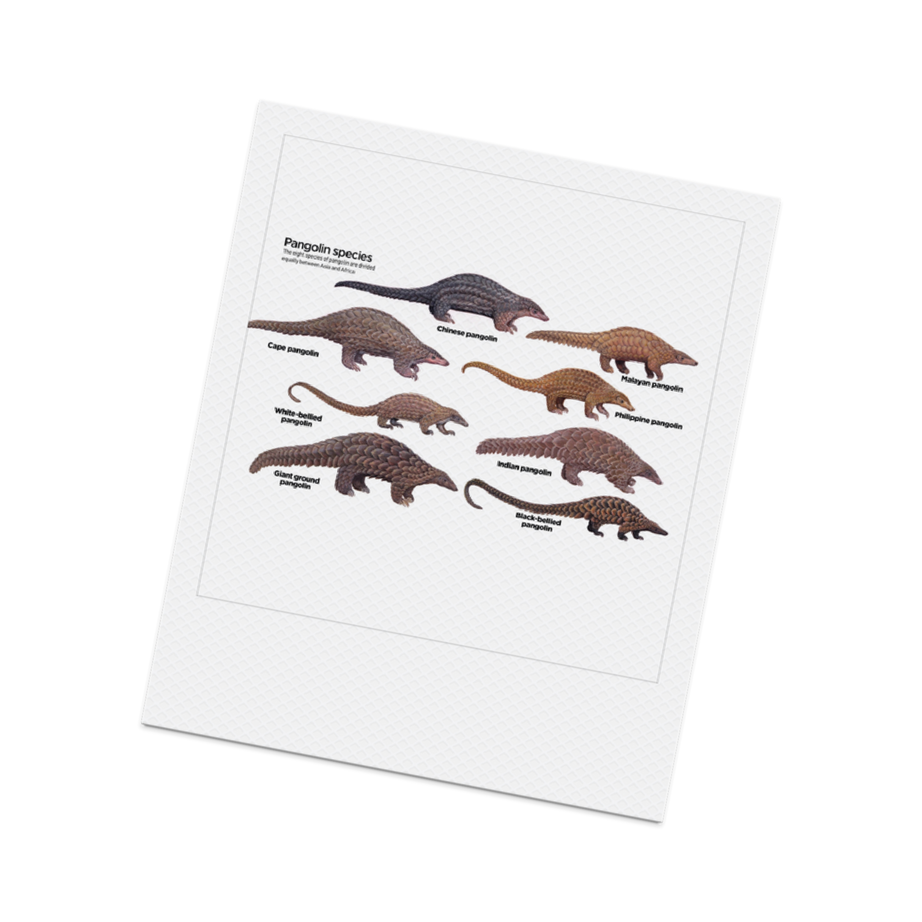
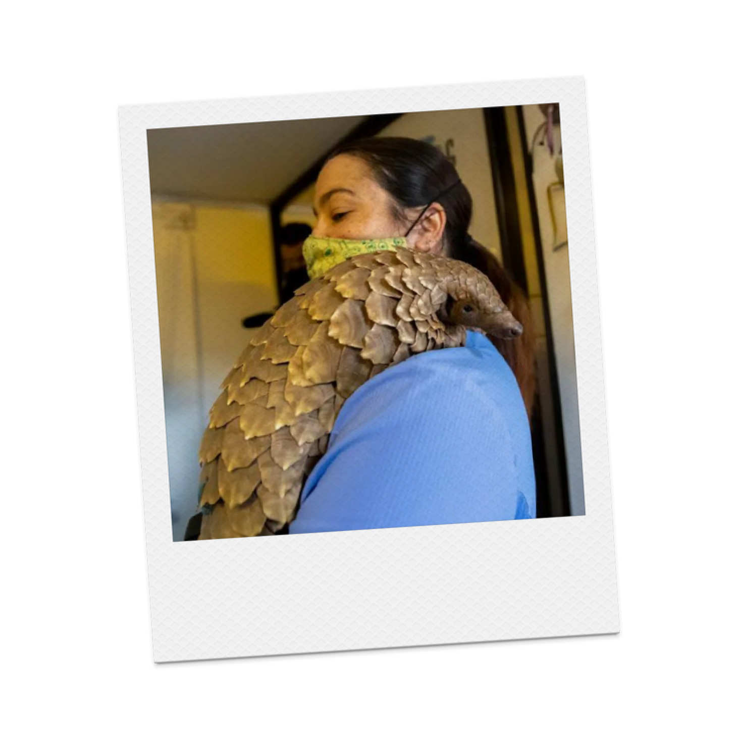





Challenges
International Trade
and demand
Lack of Awareness
and education
Illegal Wildlife Trade
Habitat loss and
fragmentation
Limited research
and knowledge
Weak law enforcement
and governance

Slide 5







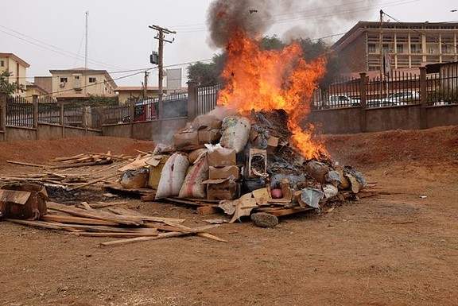

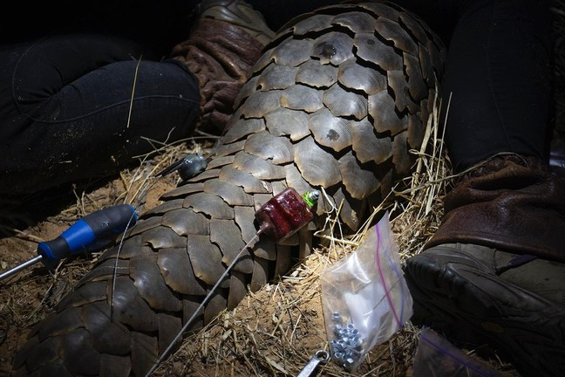
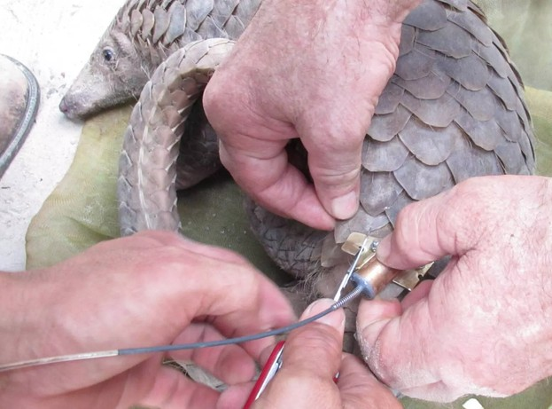

What's being done?

Slide 6
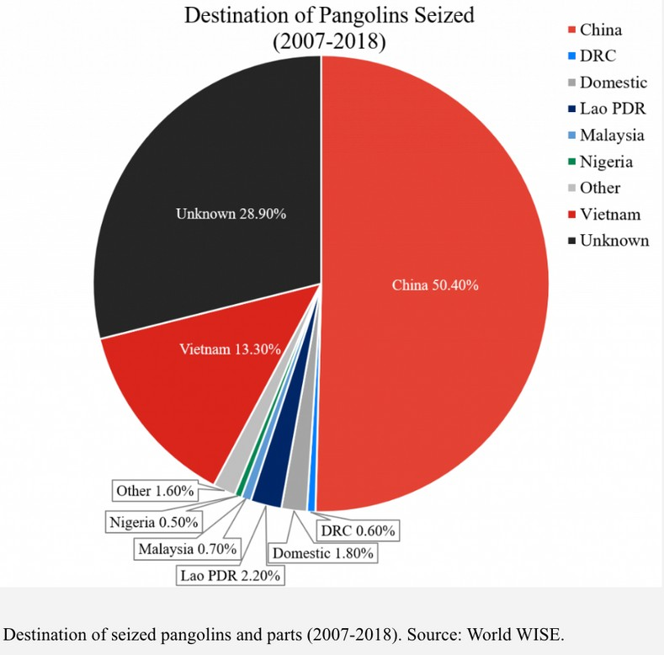




Our Solution:
Structured and accessible video- based educational media campaign
Increase the awareness of pangolins within urban and developed cities in China
Utilise the likeness of popular Chinese celebrities such as pangolin conservation supporter Jackie Chan

Slide 7

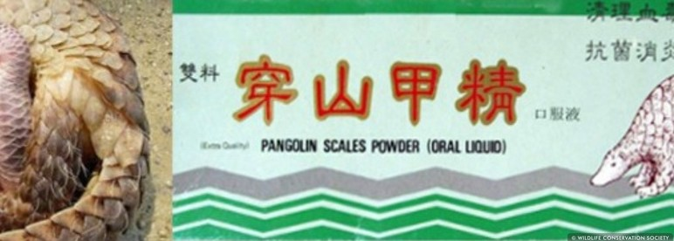
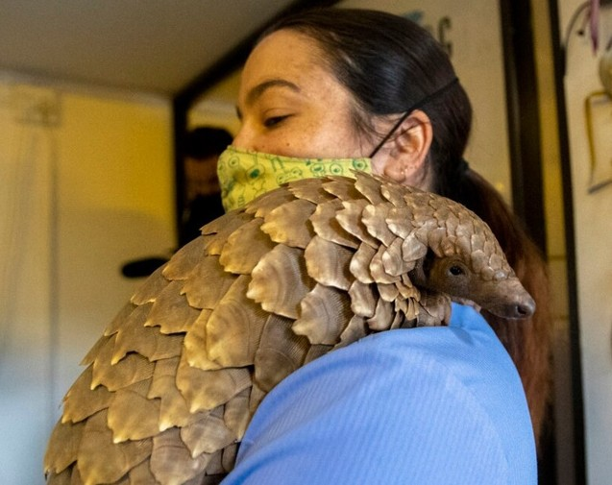


Constraints regarding the solutions
Cultural and Superstitious Beliefs
Long-Term Sustainability
Influence

Slide 8

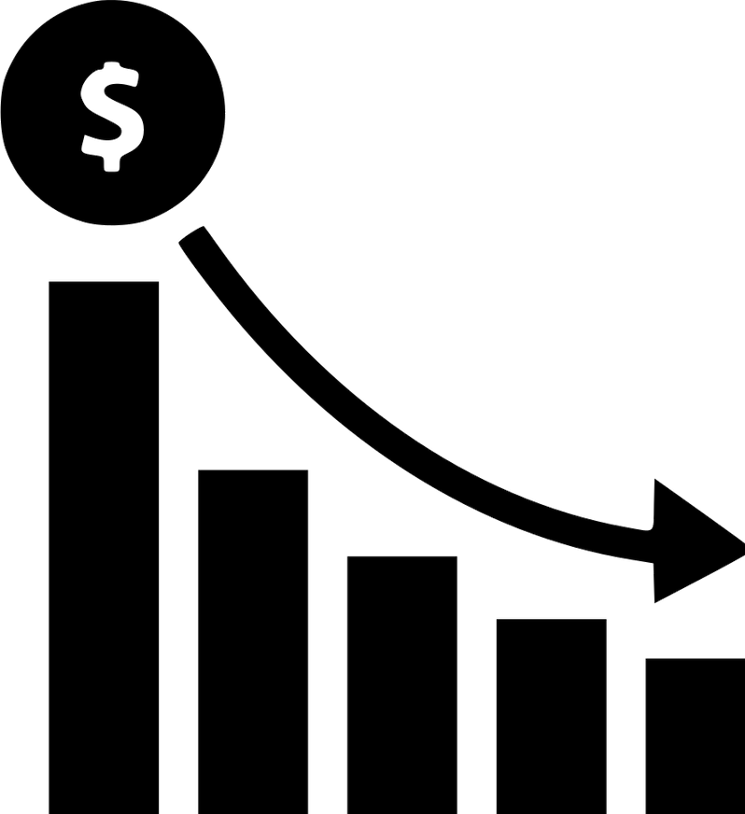

Benefits of the Solution
Reduced demand Reduced profitability Reduced trafficking

Slide 9
Possible Roadmap
CURRENT
FUTURE
Collaboration with Chinese Conservation Industry
Targeting Chinese Consumers in Cities
Strengthen Legislation and Enforcement Promote
Sustainable Alternatives Research and Monitoring

Slide 10
















TIMELINE
Year 1
Year 2-3
Year 4-5

Slide 11







CONCLUSION

Slide 12
References
Zhang, K. (2018, September 6). Consider alternatives to pangolin scales, traditional Chinese medicine professors urge at conservation conference in Hong Kong. South China Morning Post. https://www.scmp.com/news/hong-kong/health-environment/article/2162999/consider-alternatives-pangolin-scales-traditional
Huang, E. (2017, November 30). China just seized the biggest haul of the world’s most trafficked mammal. Quartz. https://qz.com/1142567/pangolin-trafficking-china-seized-record-haul-of-the-worlds- most-trafficked-mammal
Cassar, J. (2017, January 19). You’ve never heard of the world’s most poached creature. SBS News. https://www.sbs.com.au/guide/article/2017/01/19/youve-never-heard-worlds-most-poached-creature
Chao, J-T., Li, H-F. & Lin, C-C. (2020). Chapter 3 - The role of pangolins in ecosystems. https://www.sciencedirect.com/science/article/pii/B9780128155073000034#:~:text=As%20predators%20of%20ants%20and%20termites%2C%20pangolins%20perform,matter%20and%20aeration%2C%2 0and%20may%20act%20as%20bioturbators

